Slide 1
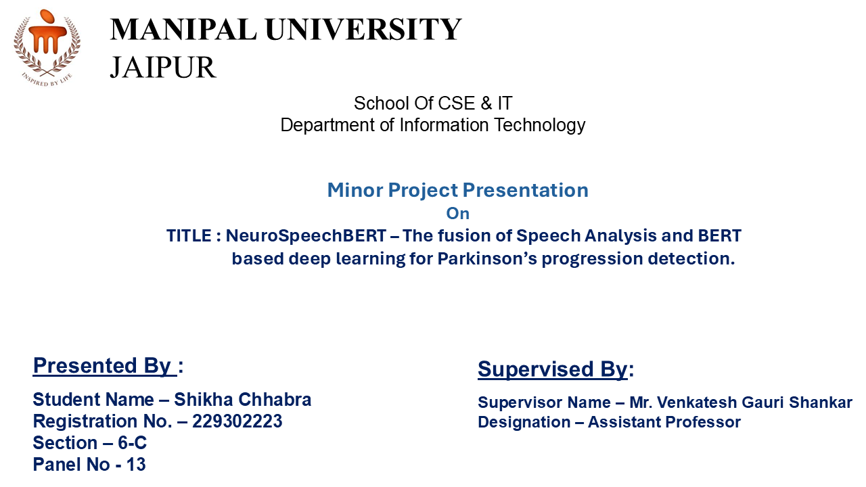
NeuroSpeechBERT
Fusion of BERT Based deep learning techniques and speech analysis for Parkinson's Stage progression detection

Slide 2
NeuroSpeechBERT
Fusion of Speech analysis and BERT -based deep learning
techniques for Parkinson's progression detection

Slide 3
CONTENTS
BACKGROUND
INTRODUCTION
METHODOLOGY
FLOWCHART
EXPERIMENTAL SETUP
RESULTS
CONCLUSION
FUTURE SCOPE
RESEARCH PAPERS
REFERENCES

Slide 4

.
.
BACKGROUND
PD affects movement and speech, with 90% of patients experiencing vocal impairments.
Speech changes (monotone, reduced loudness) can be early biomarkers for detection.
LIMITATIONS OF TRADITIONAL DIAGNOSIS
Neurological assessments are subjective, time-consuming and require specialists..
Need for automated, scalable AI solutions to enhance accuracy and efficiency.
💡 NeuroSpeechBERT aims to make PD diagnosis faster, objective and accessible using AI-powered speech analysis.

Slide 5
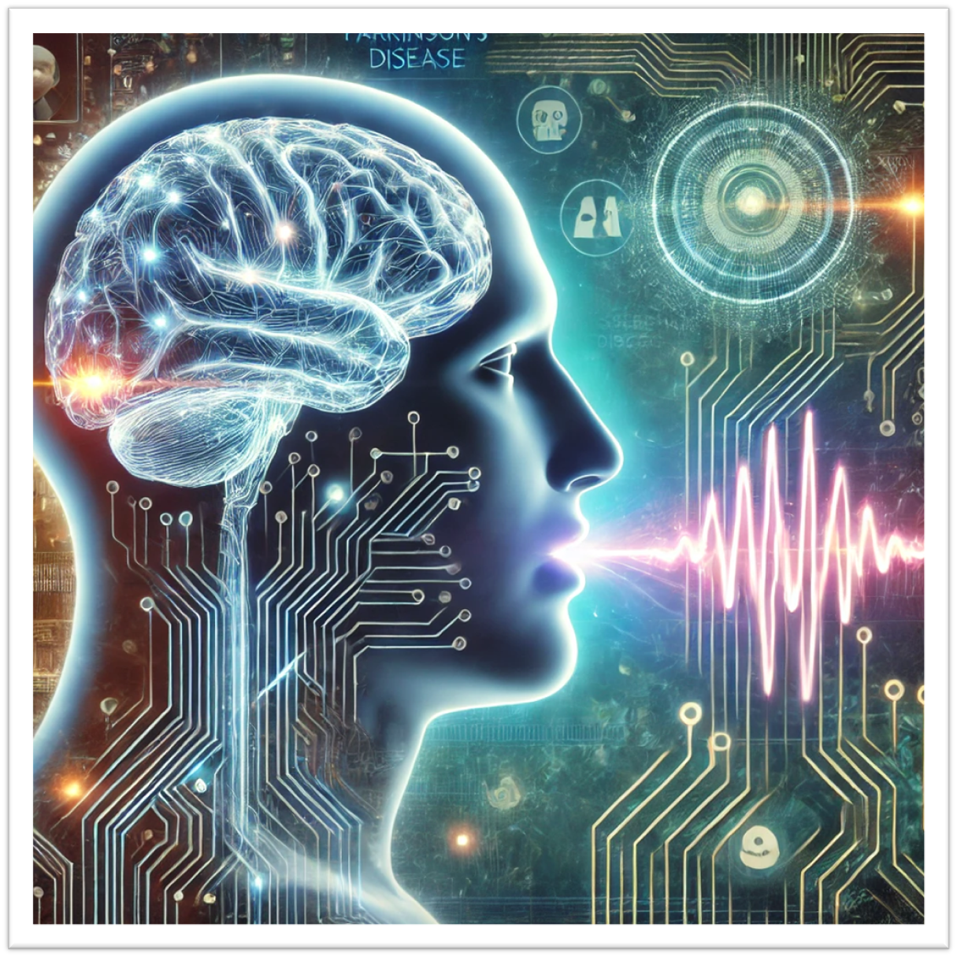
INTRODUCTION
📌 What is NeuroSpeechBERT ?
A machine learning-based approach that combines speech analysis and BERT-based deep learning to detect Parkinson’s state progression.
It utilizes audio-to-text transcription and numerical speech feature extraction for classification.
📌 Why is this Important?
Parkinson’s Disease affects speech characteristics, making voice analysis a useful diagnostic tool.
Traditional methods rely on clinical assessments, but AI-driven speech analysis offers a faster, objective, and scalable solution.
📌 Key Components of Our Approach
Speech-to-Text + BERT – Converts speech to text and applies BERT-based deep learning for classification.
Numerical Feature Extraction – Extracts key acoustic and prosodic features (Jitter, Shimmer, HNR, etc.) and applies deep learning models.
AI-Powered Diagnosis – Aims to improve early detection and progression tracking of Parkinson’s Disease.

Slide 6
METHODOLOGY
INITIAL RESEARCH & SKILL DEVELOPMENT
Studied speech analysis & deep learning with Hugging Face, Librosa, OpenSMILE & spectrogram techniques.
DATA COLLECTION & PREPROCESSING
Collected audio samples, extracted features, converted speech to text, and generated spectrograms. Applied normalization & encoding.
FEATURE ENGINEERING & SPEECH PROCESSING
Engineered acoustic, prosodic & linguistic features (MFCC, Jitter, Shimmer, Spectral, Text) and spectrogram datasets.
MODEL TRAINING
Trained deep learning models on numerical features, fine-tuned BERT on text data, and applied image models to spectrograms.
MODEL EVALUATION & OPTIMIZATION
Evaluated via accuracy, F1, ROC-AUC. Optimized models for improved generalization and robustness.
DOCUMENTATION & FINALIZATION
Prepared diagrams, documented methodology, and created reports & presentation content.

Slide 7
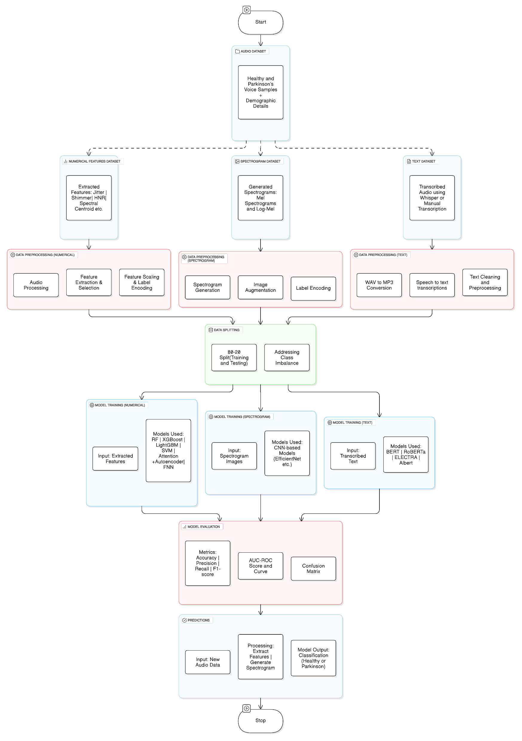

Slide 9
EXPERIMENTAL SETUP
1.DATASET PREPARATION📂
BERT-Based Text Dataset (Speech-to-Text Approach):
Healthy Controls: Extracted from Mozilla Common Voice.
Parkinson’s Patients: Extracted from SJTU Parkinson’s Speech Dataset.
Corresponding Demographic details (age, sex and label).
(b) Numerical Feature-Based Dataset (Acoustic & Prosodic Features):
Extracted from Figshare Parkinson’s Voice Dataset (Only Audio Files).
(c) Spectrogram-Based Dataset
Generated Mel and log-mel Spectrograms from the audio samples.
Used as input for image-based deep learning models.
2.DATA PREPROCESSING
Audio Preprocessing 🎵
Loaded & Visualized Audio: Imported .wav files and analysed waveforms & spectrograms.
Silence Trimming: Removed leading and trailing silence for consistency.
Normalization: Standardized volume levels across recordings.
Resampling: Converted audio to a fixed sampling rate for uniformity.
(ii)Feature extraction & selection(for numerical analysis) 📊
Extracted 67 acoustic & prosodic features using Librosa, OpenSMILE and Parselmouth.
Selected 24 significant features(Key features include Jitter, Shimmer, Pitch, Spectral Centroid, HNR, Intensity, Duration, Speaking Rate,MFCC) based on their impact on classification.

Slide 10
(iv) Data Preparation (For Numerical Features) 🔢
Encoded Class Labels: Healthy Controls (HC = 0) and Parkinson’s Disease (PD = 1).
Feature Scaling: Applied Min-Max Scaling / Z-score normalization.
Train-Test Split: 80% Training, 20% Testing.
Applied SMOTE for oversampling the minority class.
(v) Spectrogram Generation 🖼️
Computed Mel Spectrograms using Librosa.
Saved as images for deep learning models
(v)Audio-to-Text Conversion (For BERT Model) 🎧
WAV to MP3 Conversion: Loaded .wav files using pydub.AudioSegment.from_wav(). Converted and saved as .mp3 using export(format="mp3").
Speech-to-Text📝 Transcription : Used Whisper ASR (whisper.load_model()) to transcribe speech into text. Stored transcriptions as textual data.
(vi) Text Preprocessing (For Textual Input) 🔤
Lowercasing: Converted all transcriptions to lowercase.
Removing Special Characters & Punctuation:Used re.sub() to clean unwanted symbols.
Whitespace Normalization : Used re.sub(r'\s+', ' ', text) to replace multiple spaces with a single space.
Label Encoding (For BERT Model) Converted target labels (Healthy / Parkinson’s affected) into numerical format using LabelEncoder().

Slide 11
3.MODEL TRAINING 🚀
Numerical Feature-Based Models📊
✅ Input: Extracted numerical features(Jitter, Shimmer,HNR, etc.)
🧠 Models Used:
Random Forest (Hyperparameter tuning via RandomizedSearchCV)
Feedforward Neural Network (FNN) Classifier
XGBoost , LightGBM
Attention based AutoEncoder
SVM
Spectrogram-Based Deep Learning Models
✅ Input: Spectrogram Images.
🧠 Models Used:
EfficientNet-B0
ResNet -50
Inception -V3
🗣️Speech-to-Text+ BERT Model
✅ Input: Transcribed speech text (Whisper ASR)
🧠 Models Used:
BERT Fine-Tuning (Hugging Face Transformers)
RoBERTA
ELECTRA
Albert
4: MODEL EVALUATION & PERFORMANCE
Evaluation Metrics: Accuracy(Training and Testing) , Precision, Recall, F1-score,AUC Score,AUC –ROC Curve.

Slide 12
RESULTS
(a) Numerical Dataset
MODEL | TRAINING ACCURACY | TESTING ACCURACY | PRECISION | RECALL | F1- SCORE | AUC-ROC SCORE
Random Forest | 96.88 % | 82.35% | 0.81 | 0.83 | 0.81 | 0.74
Feedforward Neural Network (FNN) Classifier | 85.71% | 70.59% | 0.8 | 0.73 | 0.76 | 0.74
Light BGM | 93.75% | 58.82% | 0.5556 | 0.625 | 0.5882 | 0.5417
Attention based AutoEncoder | 65.62% | 64.71% | 0.67 | 0.5 | 0.5714 | 0.625
XG Boost | 90.62% | 64.71% | 0.625 | 0.625 | 0.625 | 0.7083
SVM | 54.29% | 47.06% | 0.79 | 0.59 | 0.44 | 0.47

Slide 13
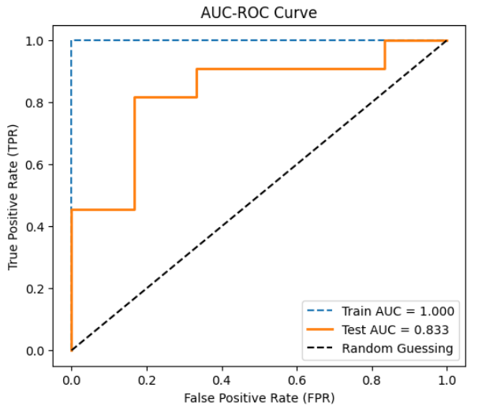
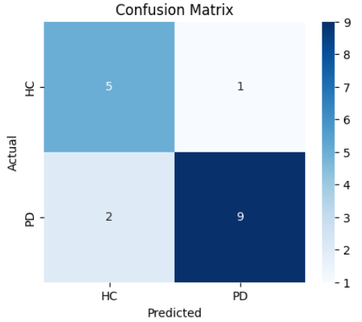
(i) Random Forest
Precision : 0.81
Recall : 0.83
F1 Score : 0.81
AUC-ROC Score : 0.74

Slide 14
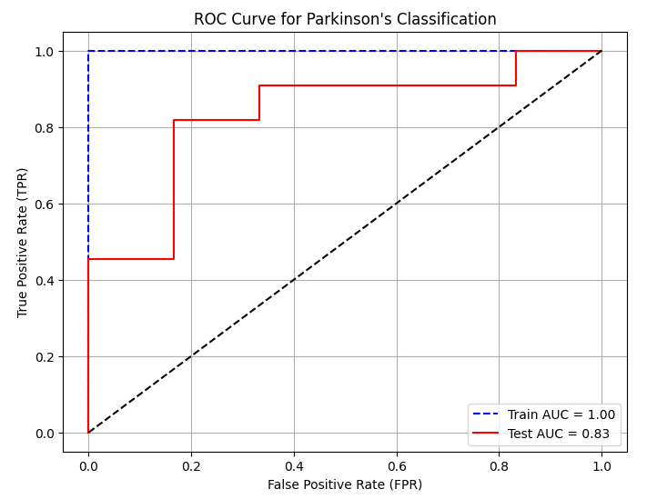
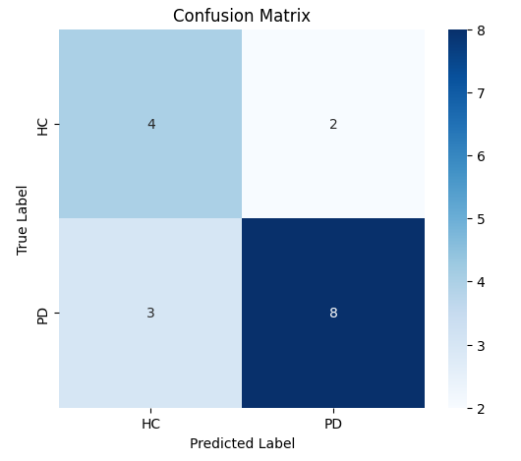
(ii) Feedforward Neural Network (FNN) Classifier
Precision : 0.8
Recall : 0.73
F1 Score : 0.76
AUC-ROC Score : 0.74

Slide 15
RESULTS
(b) Spectrogram-Based Model
MODEL | SPECTOGRAM TYPE | TRAINING ACCURACY | TESTING ACCURACY | PRECISION | RECALL | F1- SCORE | AUC-ROC SCORE
EfficientNet-B0 | Log Mel Spectrogram | 93.75% | 88.24% | 0.88 | 0.88 | 0.88 | 0.9286
ResNet -50 | Log Mel Spectrogram | 79.69% | 76.47% | 0.76 | 0.76 | 0.76 | 0.7778
Inception -V3 | Log Mel Spectrogram | 78.12% | 70.59% | 0.83 | 0.64 | 0.62 | 0.6143
EfficientNet-B0 | Mel Spectrogram | 67.95% | 70.97% | 0.73 | 0.69 | 0.69 | 0.8361

Slide 16
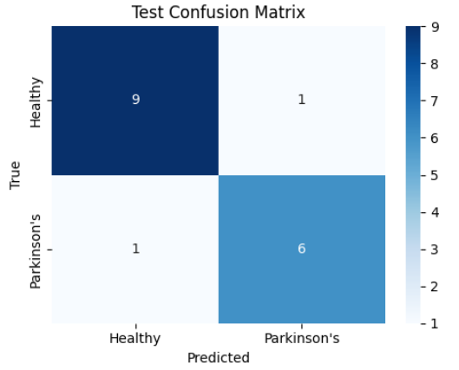
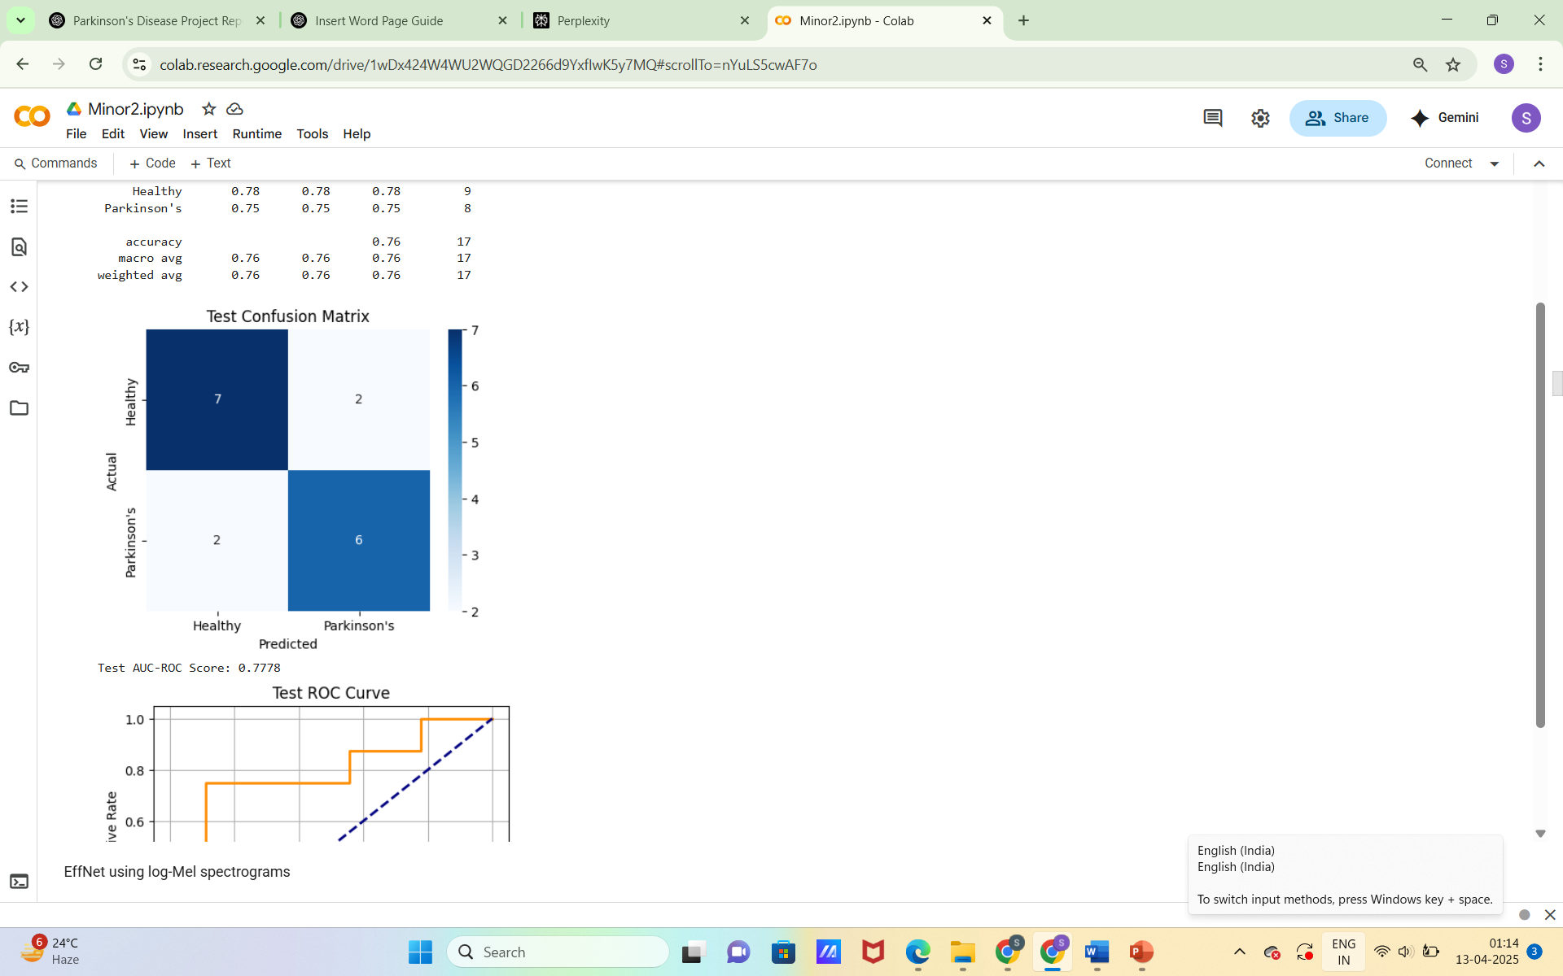
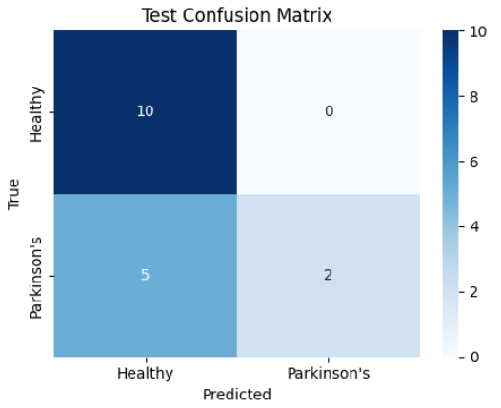
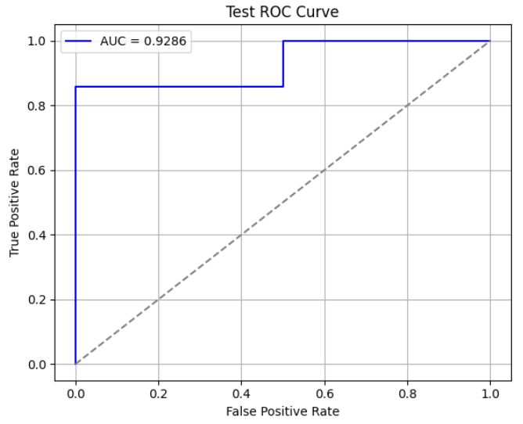
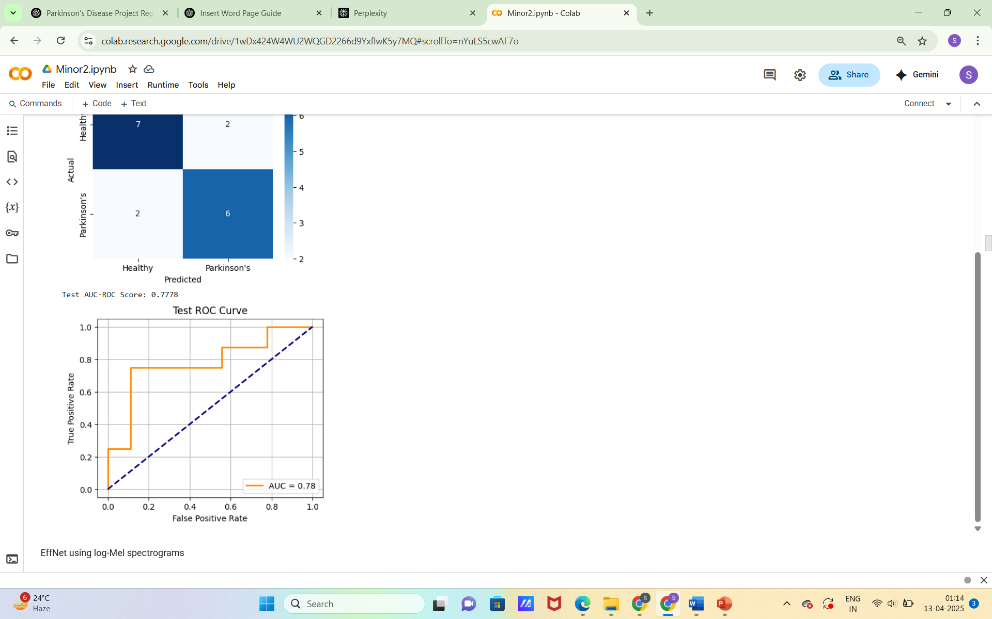
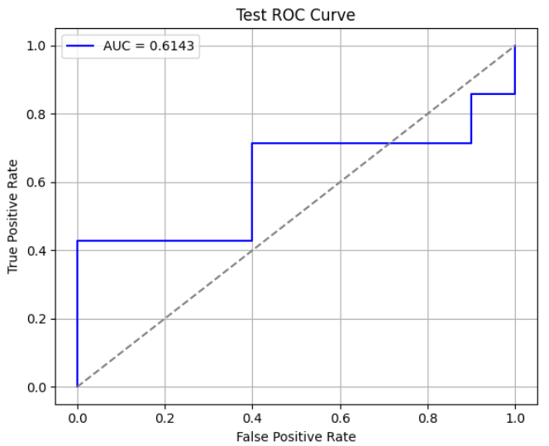
(ii) ResNet -50
(i) EfficientNet-B0
(iii) Inception -V3

Slide 17
RESULTS
(c) Textual Dataset
MODEL | TRAINING ACCURACY | TESTING ACCURACY | PRECISION | RECALL | F1- SCORE | AUC-ROC SCORE
BERT | 99% | 97.4% | 0.98 | 1.0 | 0.99 | 0.9624
Roberta | 99.19% | 97.23% | 0.97 | 0.97 | 0.97 | 0.9723
Electra | 99.65% | 98.85% | 0.99 | 0.99 | 0.99 | 0.9970
Albert | 99.13% | 97.46% | 0.97 | 0.98 | 0.97 | 0.9992

Slide 18
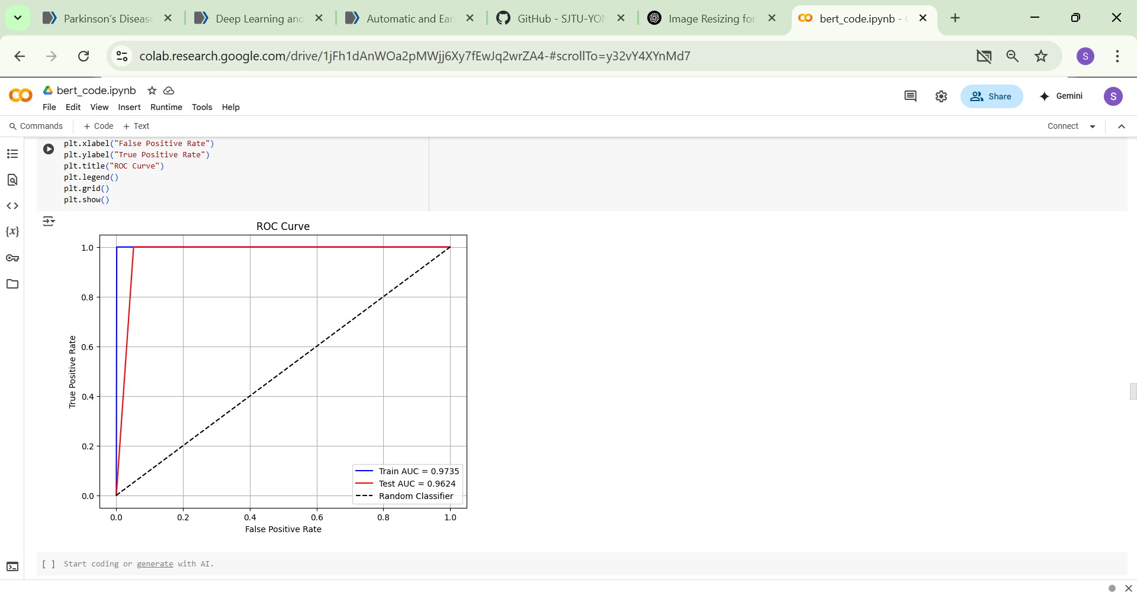
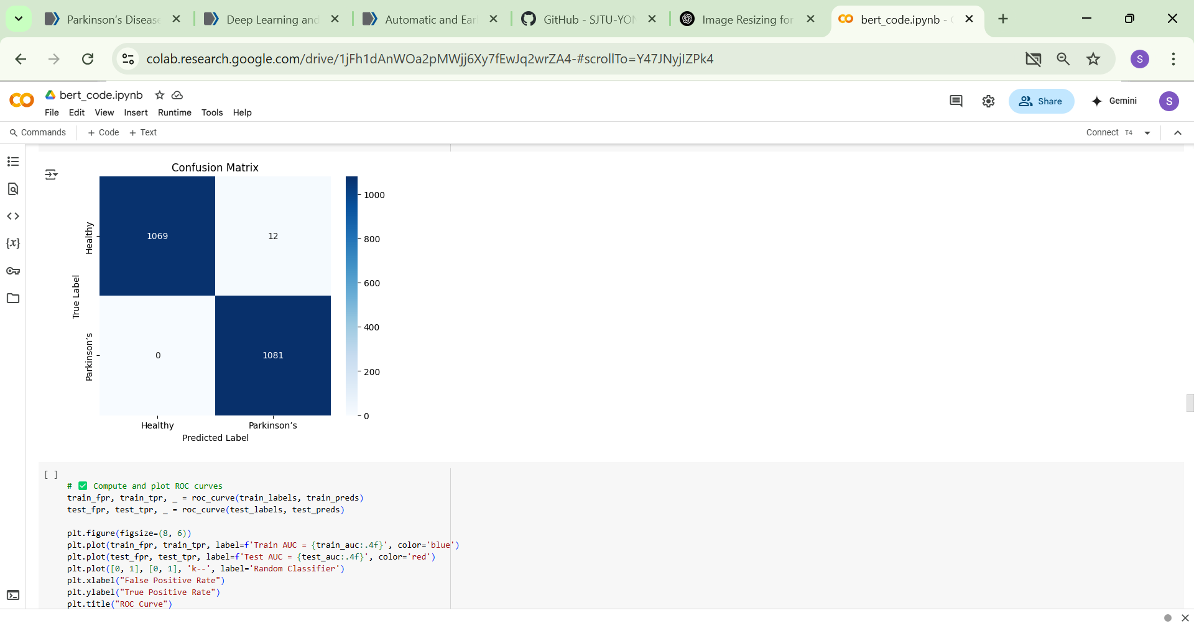
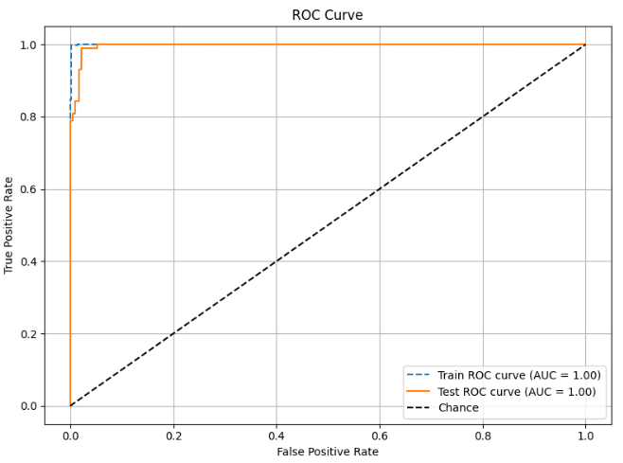
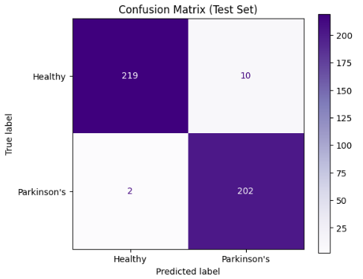
(i) BERT (fine-tuned)
(ii) Roberta

Slide 19
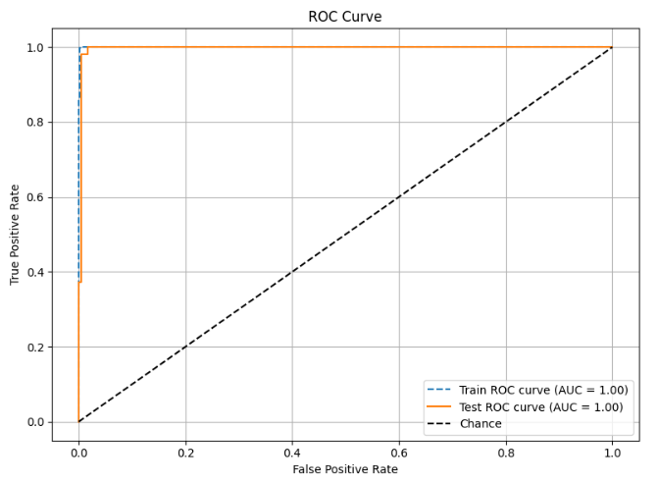
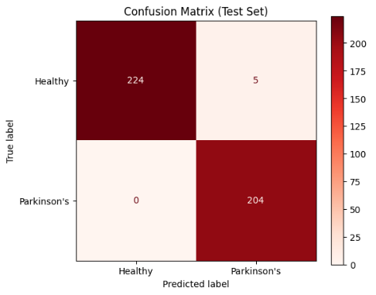
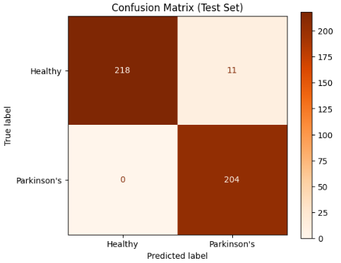
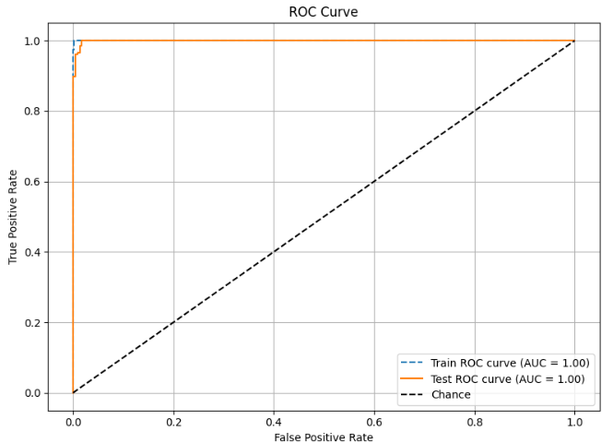
(iii) Electra
(iv) Albert

Slide 20
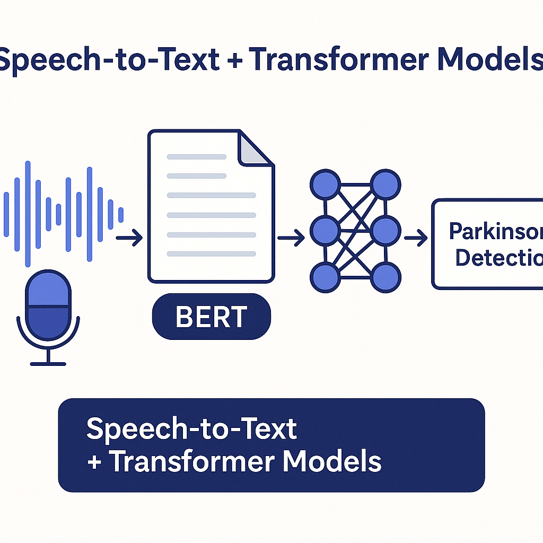
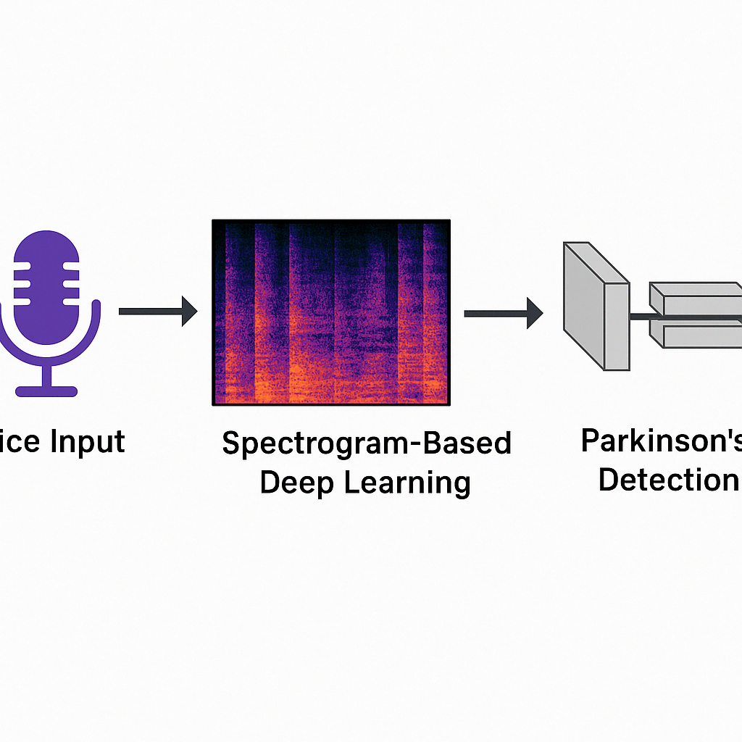
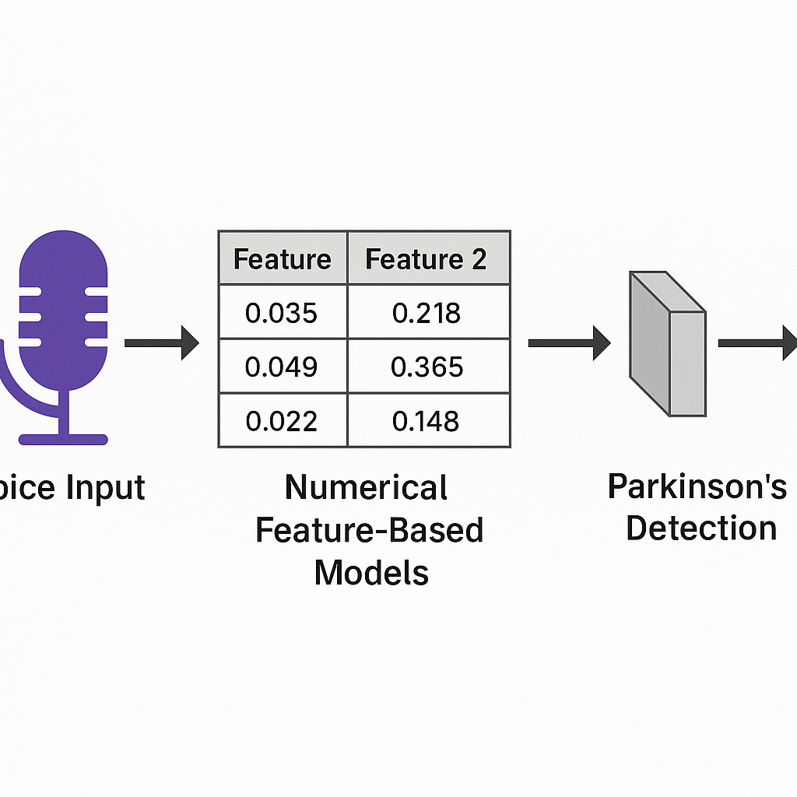
CONCLUSION
“This project explored a multi-branch deep learning framework for Parkinson’s Detection using voice samples.”
Speech-to-Text + Transformer Models (BERT, RoBERTa, ELECTRA,Albert) → Delivered the highest classification performance with accuracies consistently exceeding 95%, confirming the effectiveness of text-based representations in capturing Parkinson’s-related vocal patterns.
Spectrogram-Based Deep Learning Models (EfficientNet, CNN) → Achieved moderate success with accuracies ranging from 60% to 80%, highlighting the visual patterns in speech but revealing room for improvement.
Numerical Feature-Based Models → Provided acceptable but comparatively lower accuracy due to limited features and dataset scale.
Conclusion: The Transcription + Transformer approach proves to be the most reliable for Parkinson’s detection,
offering robust generalization over other representations.

Slide 21

FUTURE SCOPE
"Expanding the system’s generalizability and clinical usefulness."
Dataset Expansion Incorporate more diverse and balanced voice recordings across demographics, clinical stages, and environments to improve model robustness and generalization.
Intermediary Stage Classification Upgrade from simple binary classification to multi-class prediction — differentiating Healthy, Early-Stage, and Advanced Parkinson’s.
Model Ensemble Combine insights from Numerical Features, Text-based Transcriptions (BERT), and Spectrogram Images to improve decision reliability and accuracy.
Multilingual Evaluation Extend the system to support voice data in multiple languages and accents, ensuring adaptability across diverse populations.

Slide 22
RESEARCH PAPER
Title: NeuroSpeechBERT : Fusion of BERT Based deep learning techniques and speech analysis for Parkinson's Stage progression detection. (DRAFT SUBMITTED TO SIR)

Slide 23
REFERENCES
Alalayah KM, Senan EM, Atlam HF, Ahmed IA, Shatnawi HSA. Automatic and Early Detection of Parkinson's Disease by Analyzing Acoustic Signals Using Classification Algorithms Based on Recursive Feature Elimination Method. Diagnostics (Basel). 2023 May 31;13(11):1924. doi: 10.3390/diagnostics13111924. PMID: 37296776; PMCID: PMC10253064.
A. Nogales, Á. J. García-Tejedor, A. M. Maitín, A. Pérez-Morales, M. D. D. Castillo and J. P. Romero, "BERT Learns From Electroencephalograms About Parkinson’s Disease: Transformer-Based Models for Aid Diagnosis," in IEEE Access, vol. 10, pp. 101672-101682, 2022, doi: 10.1109/ACCESS.2022.3201843.
Escobar-Grisales D, Ríos-Urrego CD, Orozco-Arroyave JR. Deep Learning and Artificial Intelligence Applied to Model Speech and Language in Parkinson's Disease. Diagnostics (Basel). 2023 Jun 25;13(13):2163. doi: 10.3390/diagnostics13132163. PMID: 37443557; PMCID: PMC10340628.
C. Quan, K. Ren, Z. Luo, Z. Chen, and Y. Ling, “End-to-end deep learning approach for Parkinson’s disease detection from speech signals,” Biocybernetics and Biomedical Engineering, vol. 42, no. 2, pp. 556–574, 2022. doi: 10.1016/j.bbe.2022.04.002.4
A. Favaro et al., "Interpretable speech features vs. DNN embeddings: What to use in the automatic assessment of Parkinson’s disease in multi-lingual scenarios," Computers in Biology and Medicine, vol. 166, p. 107559, 2023.
M. R. Salmanpour et al., "Feature selection and machine learning methods for optimal identification and prediction of subtypes in Parkinson’s disease," Computer Methods and Programs in Biomedicine, vol. 206, p. 106131, 2021.
https://github.com/SJTU-YONGFU-RESEARCH-GRP/Parkinson-Patient-Speech-Dataset/
https://figshare.com/articles/dataset/Voice_Samples_for_Patients_with_Parkinson_s_Disease_and_Healthy_Controls/23849127

Slide 24


